Slide 1
Neuroscience
TBL 1
Note: Check “Notes” of each slide for the answer

Slide 2
Q.1 The resting membrane potential of a cell results from the fact that there is an unequal distribution of charged ions across the membrane. Which of the following is most important in maintaining this unequal dirstribution?
High extracellular concentration of Sodium
High intracellular concentration of Potassium
Presence of non-diffusible negatively charged molecules inside the cell
The electrogenic propery of the Na+/K+ ATPase
The membrane is more permeable to certain ions than others
Notes:
C

Slide 3
Q.2 While experimenting with a nerve-muscle preparation, a medical student adds a solution that caused the nerve to generate action potentials and the muscle to contract. The solution added most likely contained a high concentration of which of the following ions ?
Ca⁺²
Cl⁻
H⁺
K⁺
Na⁺
Notes:
D

Slide 4
Q.3 During a neuronal action potential there is a period when the cell cannot be activated by another stimulus, no matter how strong. This period is known as the:
Absolute refractory period
Depolarization period
Hyperpolarization period
Relative refractory period
Repolarization period
Notes:
A

Slide 5
Q.4 you discover a neurotransmitter. You demonstrate that it acts by activating a metabotropic receptor leading to closure of a K+ Channel. What type of post synaptic potential would you predict in the target cell?
Fast excitatory post synaptic potentials
Fast inhibitory post synaptic potentials
Fast miniature end-plate potentials
Slow excitatory post synaptic potentials
Slow inhibitory post synaptic potentials
Notes:
D

Slide 6
Q.5 You stimulate a neuron A to fire an action potential and record a synaptic response from neuron B. Which of the following is most consistent with the idea that the connection between A and B is mediated by an electrical synapse?
Absence of a delay in the response of neuron B
An action potential in neuron B elicits an EPSP in neuron A
An action potential in neuron B elicits an IPSP in neuron A
An increase in external calcium enhances the synaptic response of neuron B
Neuron B is much larger than neuron A
Notes:
A

Slide 7
Q.6 In which of the following reflexes is the primary response an inhibition of the effector ?
Cremasteric reflex
Crossed extensor reflex
Golgi tendon reflex
Myotatic (stretch) reflex
Withdrawal reflex
Notes:
C

Slide 8
Q.7 Twenty two years old Zafar received multiple stab wounds in the back while resisting an attempted robbery, An MRI done the next day showed hemi-section of the spinal cord at the level of the left T8 vertebra. Which one of the following spinal segments corresponds to T8 vertebral level ?
L1
T10
T11
T8
T9
Notes:
C

Slide 9
Q.8 A neurological exam of a patient with spinal cord injury showed left lower limb stiffness with brisk deep tendon reflexes. The reason for brisk tendon reflexes is:
Lesion in the cerebellum
Lesion in the basal ganglia
Lower motor neuron lesion
Spinal shock
Upper motor neuron lesion
Notes:
E

Slide 10
Q.9 Which of the following signs on examination is indicative of a complete hemi-section involving the dorsal column?
Contralateral loss of conscious proprioception below the level of the lesion
Contralateral loss of discriminative touch starting at 1-2 segments below the level of the lesion
Intact vibratory sensation ipsilaterally below the level of the lesion
Ipsilateral loss of conscious proprioception below the level of the lesion
Loss of pain and temperature sensation ipsilaterally below the level of the lesion
Notes:
D

Slide 11
Q10. Which one of the following represents the embryological origin of the structure lying on either side of the third ventricle?
Diencephalon
Mesencephalon
Metencephalon
Myelencephalon
Telencephalon
Notes:
A

Slide 12
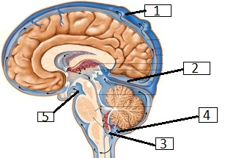
Q.11 The following diagram is showing the structural organization of meninges and interventricular system of the brain. Which one of the following labels is pointing to Arachnoid Villi?
1
2
3
4
5
Notes:
A

Slide 13
Q.12 Which one of the following cells is the resident macrophage of the central nervous system ?
Astrocytes
Microglia
Oligodendrocytes
Pyramidal cells
Schwann cells
Notes:
B

Slide 14
Q.13 A 65 year old woman has been receiving hemodialysis for chronic renal failure and has noted increasing loss of sensation in her legs for the past 2 years. On physical examination, there is symmetrically decreased sensation over both lower extremities. She has no decrease in strength or abnormality of gait. What is most likely diagnosis in this case ?
Systemic vasculitis
Diabetes mellitus
Paraneoplastic syndrome
Guillain-Barré syndrome
Chronic inflammatory demyelinating polyneuropathy
Notes:
B

Slide 15
Q.14 A 35-year-old man had an influenza-like illness for one week. A few days later, he experienced a rapidly progressive, ascending motor weakness that required intubation and mechanical ventilation. On physical examination, he is now afebrile and has 3/5 motor strength in his extremities. The patient recovers completely in 3 weeks. Which of the following laboratory test findings would you have most likely expected to be present during his illness ?
CSF with albominocytologic dissociation
Decreased serum level of vitamin B12
Increased amount of lead in plasma
Mutation in PMP22
Serum glucose of 210 mg/dL
Notes:
A

Slide 16
Q.15 Among local anesthetics, the esters have a shorter half-life than the amides. This effect is attributed to:
Extensive hepatic metabolism
Lower plasma protein binding
Non-enzymatic degradation
pH-dependent inactivation in tissues
Plasma esterases
Notes:
E

Slide 17
Q.16 Among intravenous anesthetics Thiopental has a shorter duration of action as an intravenous anesthetic due to:
Extensive hepatic metabolism
High volume of distribution
Plasma esterases
Redistribution
Renal clearance
Notes:
D

Slide 18
Q.17 A patient was admitted to the neurology ward with ascending paralysis. His medical history was significant for gastrointestinal infection caused by Gram negative curved bacilli a few weeks before onset of neurological symptoms. The doctor confirmed that the present condition is linked to his recent infection. The most likely underlying pathology is:
Demyelination due to autoimmune response
Focal myelin stripping by B-lymphocytes
Toxin induced inhibition of neurotransmitters at the peripheral synapses
Reactivation of latent organisms in the dorsal ganglion
Demyelination due to direct bacterial infection
Notes:
A

Slide 19
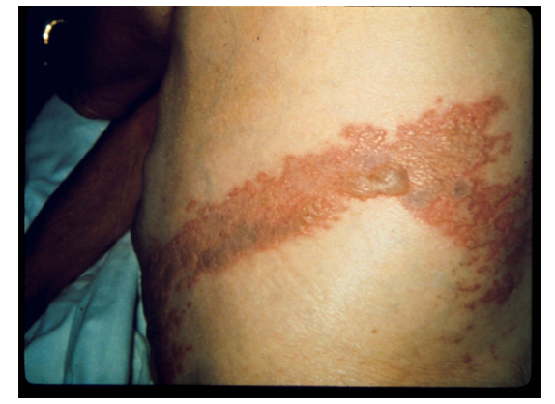
Q.18 A 65 year old man presented vesicular lesion shown in the image below. Laboratory investigation confirmed presence of IgM against Varicella Zoster virus. Which one of the following is most likely to be true for this condition?
It is a manifestation of primary Varicella Zoster virus infection
Acute neuritis occurs as a prodromal symptom
Appearance of lesions is preceded by a phase of viraemia
Droplet precautions should be instituted for infection control
Increased pain perception is due to an autoimmune neuropathy.
Notes:
B

Slide 20
SAQ

Slide 21
Clinical Scenario
On a rainy day 20-year-old Abdullah Haider slipped from the rooftop of his house, injuring his neck. He was rushed to a hospital where the physician noted that he was unable to move right side of his body. He had a heart rate of 88/min and a blood pressure of 110/75 mm of Hg. Initial neurological examination showed depressed motor and sensory function in both upper and lower limbs. The anal reflex was also absent. After 24 hours, Neurological examination showed a flaccid and weak right side of the body and loss of position and vibratory sensations below the level of C5 on the right side. There was also left-sided loss of pain, temperature and crude touch below the level of C5 and a complete loss of sensation in C5 dermatome on the left side. On CT scan, a piece of fractured vertebra was found impacted in the spinal cord at C5 level on the right side. The patient was then operated upon to remove the bone fragment and repair the damaged vertebra. After 1 month on subsequent clinic visit, a comprehensive neurological examination revealed the same deficits except for increased tone in all muscles on the right side of the body. The abdominal and deep tendon reflexes were exaggerated on right side.

Slide 22
Q. 1: Give reason for depressed motor and sensory function in both upper and lower limbs and absent anal reflex. (2 marks)
Q. 2: Name the tract which is responsible for conducting position and vibratory sensation. (2 marks)
Q. 3: Explain why pain and temperature sensations are lost on left side below C5 while position and vibratory sense are lost on the right side in this case? (4 marks)
Q. 4: Why he developed exaggerated deep tendon reflexes on right side? (2 marks)
Notes:
1: Spinal Shock
2: Dorsal column
3: Pain & temperature → Lateral spinothalamic tract→ synapse at same spinal cord level then decussate → injury would manifest on contralateral side
Position & vibratory sense → Dorsal column → ascends through spinal cord to medulla where it synapses then decussate → injury in spinal cord would manifest on ipsilateral side
4: UMN lesion → LMN aren’t inhibited → exaggerated reflexes (not inhibited by UMN)

Slide 23
Good Luck! ☺
Tarek Konbaz

